Slide 1
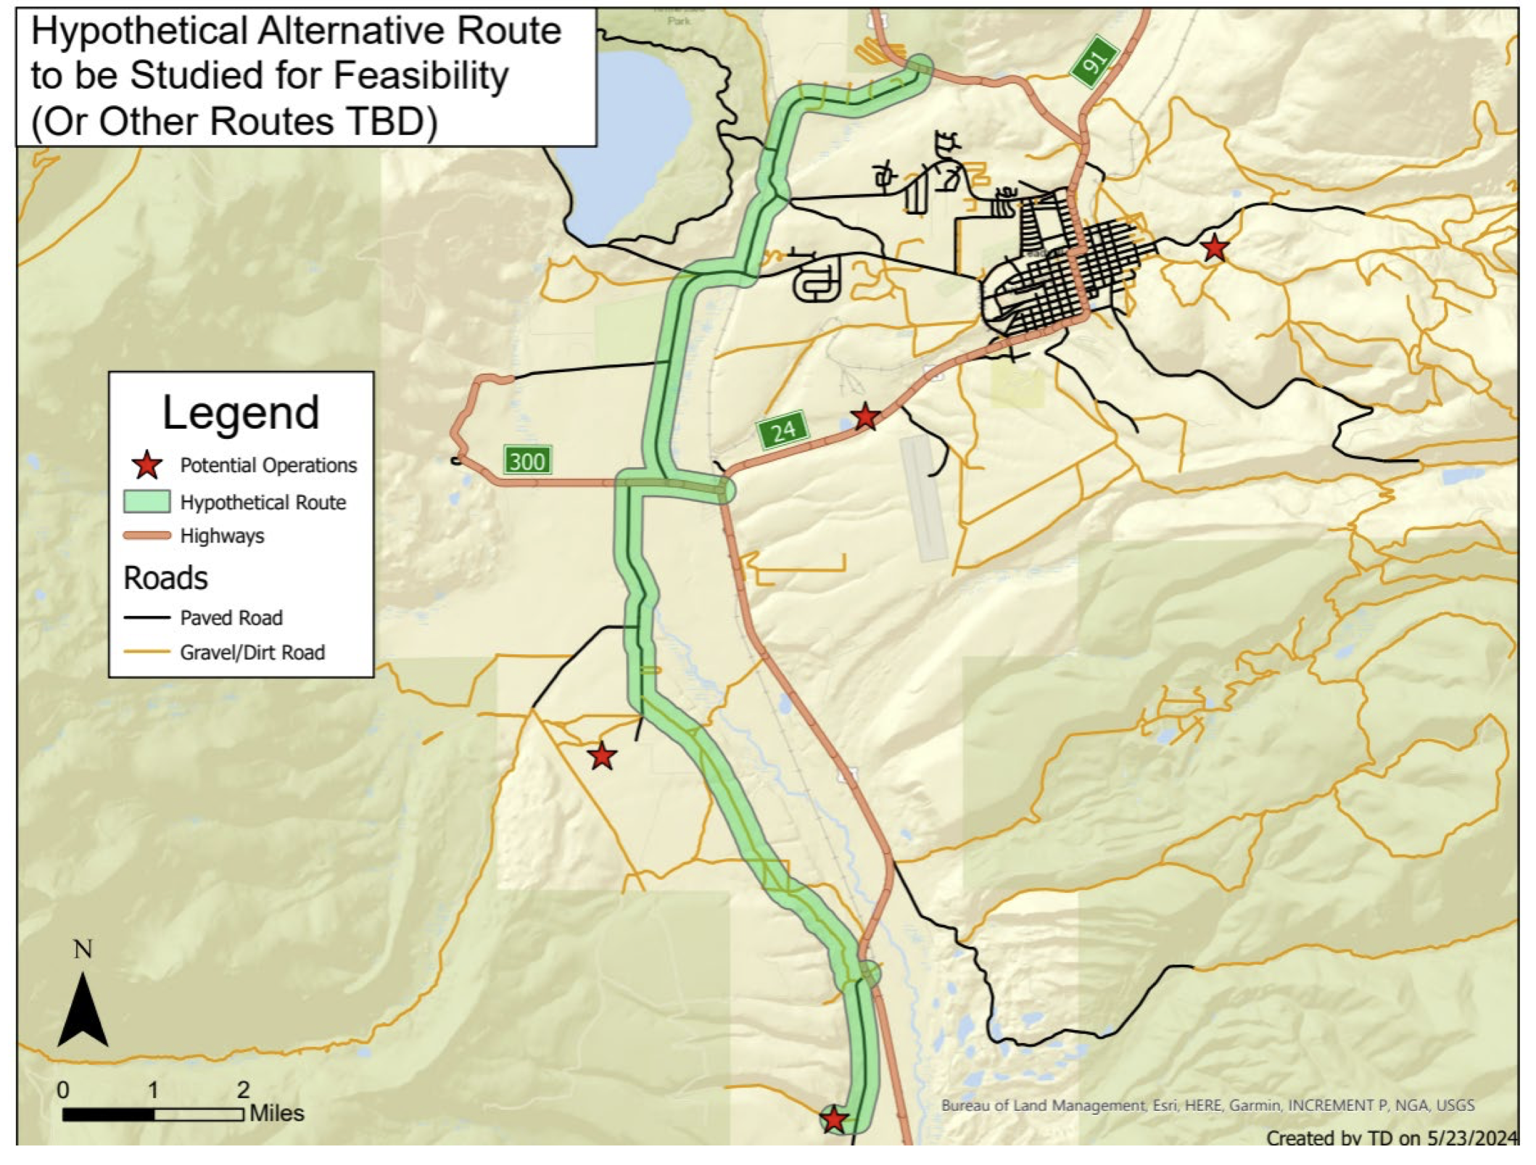
Feasibility Study for CR 99 Truck By-Pass Route

Slide 2
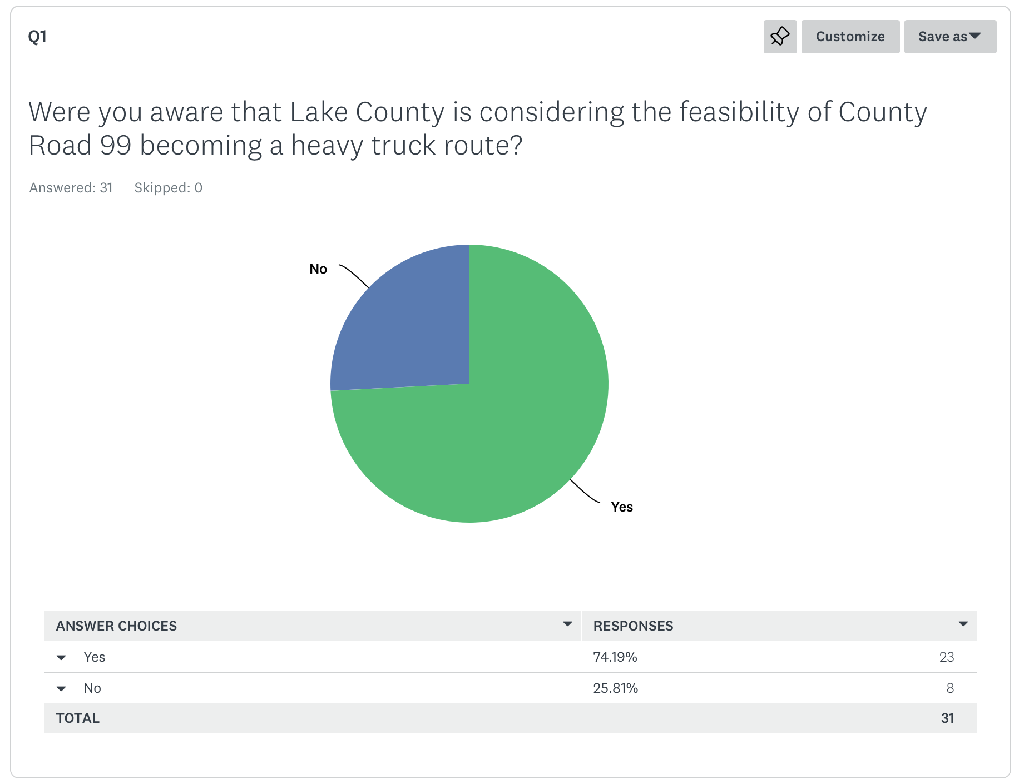

Slide 3
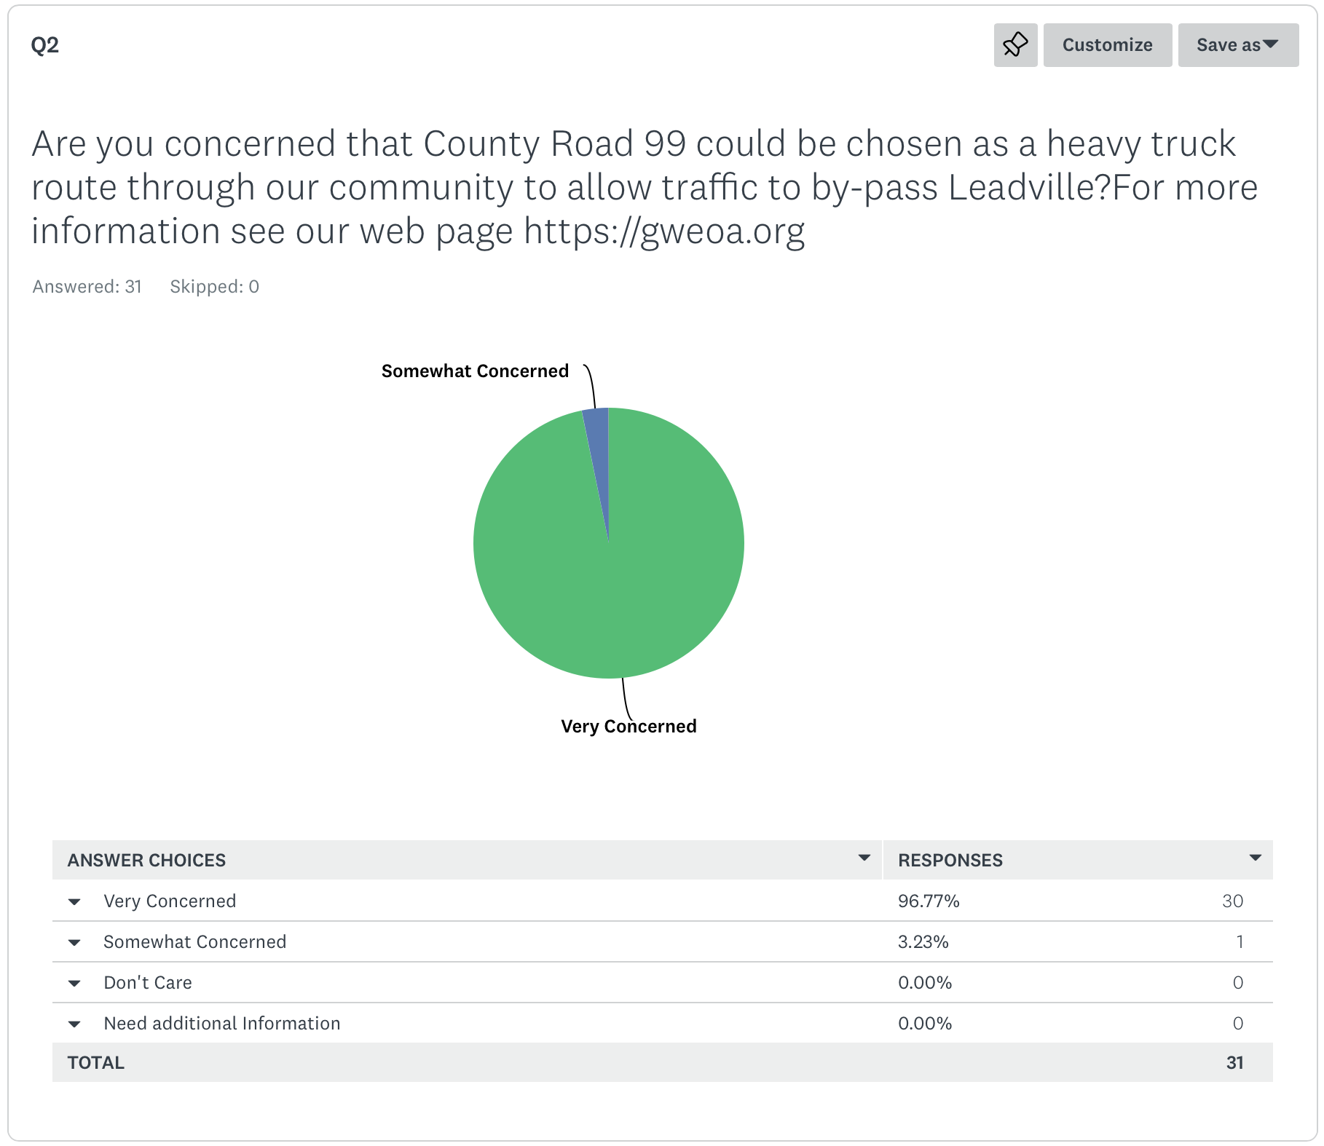

Slide 4
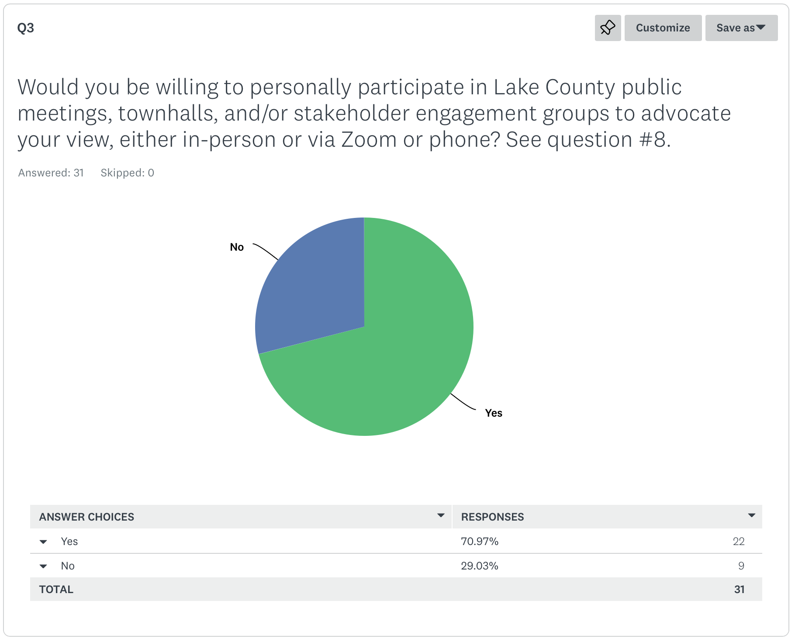

Slide 5
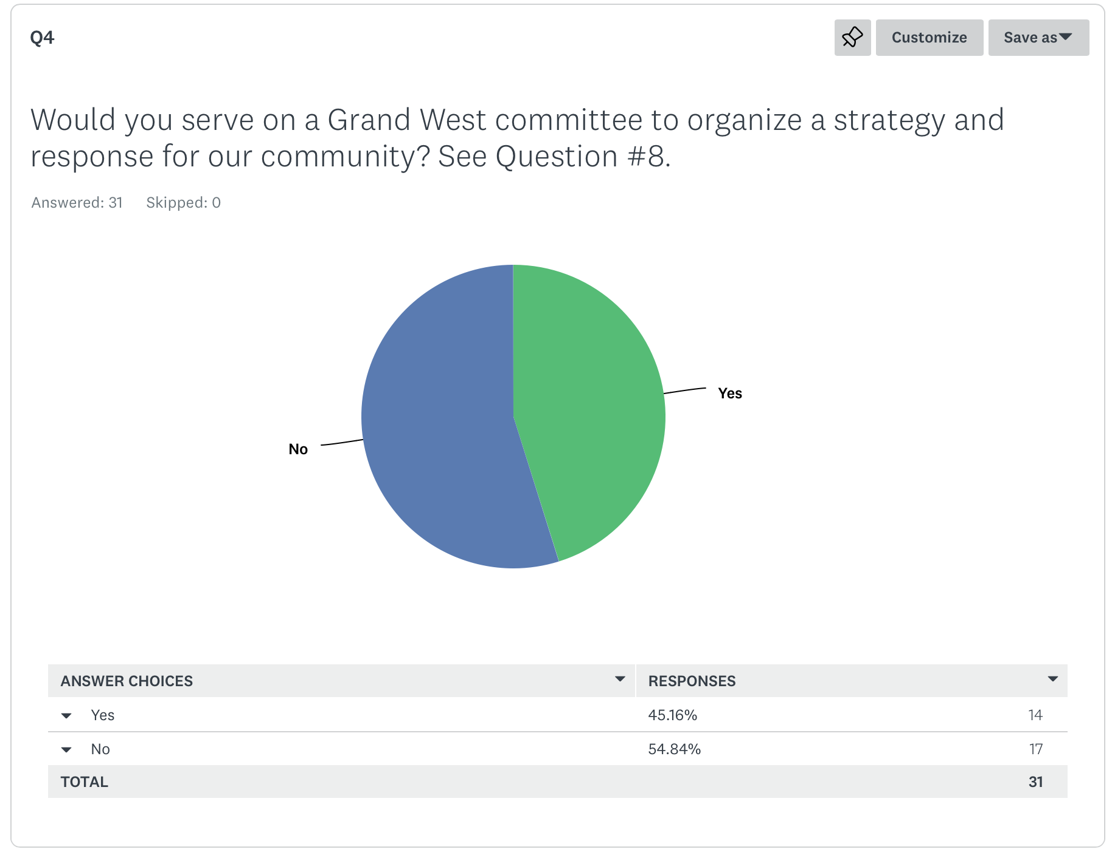

Slide 6
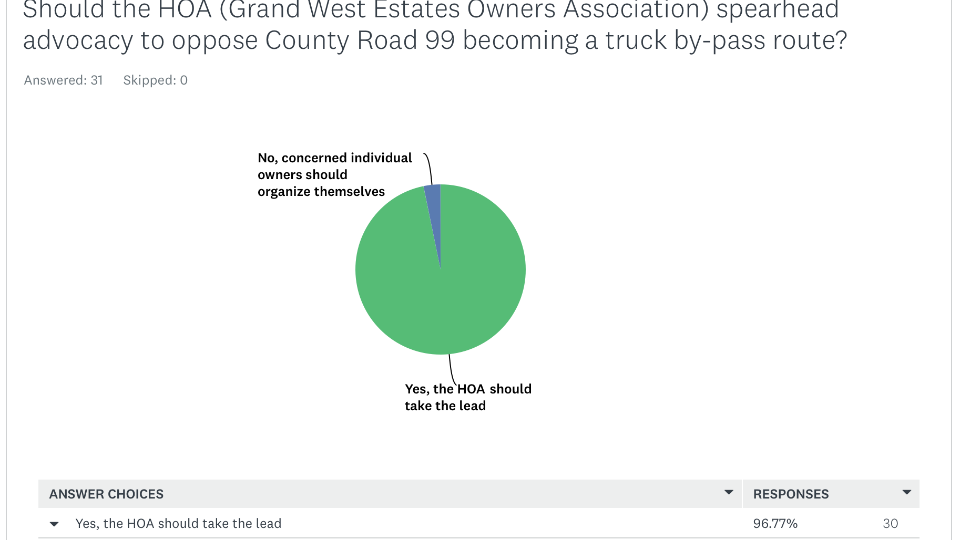

Slide 7
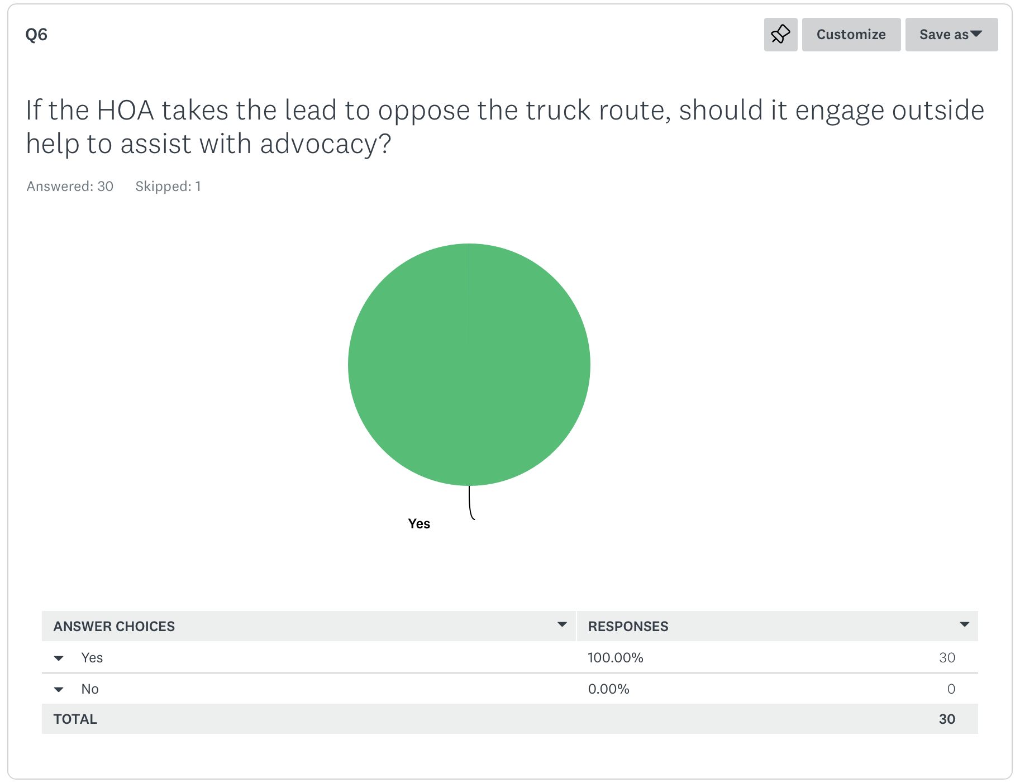

Slide 8
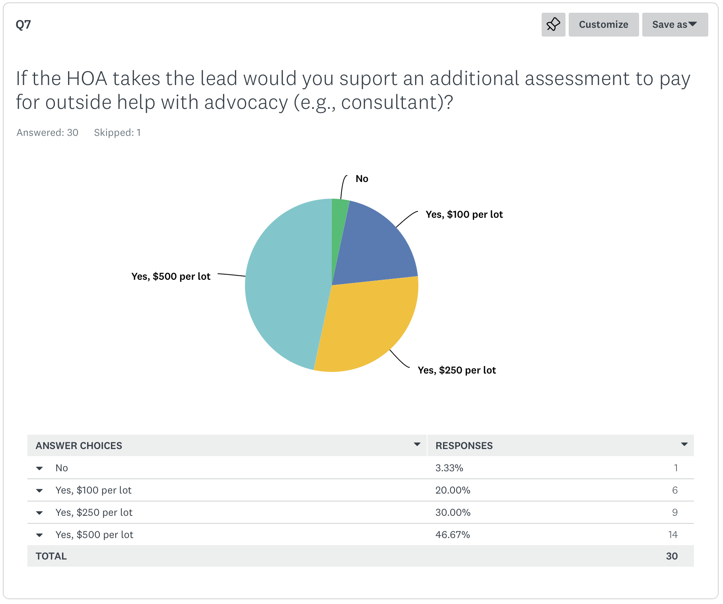

Slide 9


Slide 10
WHY?
What is the need?
  Traffic Study
  Current Route Improvements
  City of Leadville – skin in the game?
  De-emphasize heavy truck industry
    Gravel Pit in northern Lake County - Birdseye.

